Slide 1
OBI/CLO/CL/ReO Alignment Call #2
10-24-12

Slide 2
Post-Call Summary
I. DECISIONS
1. Cell cultures and lines will be modeled at the level of cells in CLO, as is being pursued in their current refactoring work. A hierarchy of top level categories was proposed to be implemented under CL:experimentally modified cell that distinguishes the following classes:
experimentally modified cell in vitro
cell culture cell (any cell in culture)
primary cell culture cell (cell in culture before any passaging)
cell line cell (cell that has been passaged in culture)
finite cell line cell (cell line cell that has capacity for only finite replication)
permanent cell line cell (cell line cell that has capacity for indefinite replication)
2. An agreement was reached on the distinctions between 'cell culture cell' and 'cell line cell':
cell culture cells are necessarily under active culture conditions, whereas cell line cells are can be under culture conditions or can be frozen/stored in quiescent state awaiting future culturing
cell culture cells represent ANY cell in culture, whereas cell line cells represent include only those cells that have been passaged at least once in culture (ie represent "subsequent generations of a primary cell culture cell")
Dissenting opinions here were concerned about the subtleness and complexity of these distinctions and the model that results, in which cell culture cell and cell line cell are siblings and largely non-disjoint. The definitions and example should be clear and detailed enough to make these distinctions apparent, and we can revisit alternate ideas if proposed model encounters problems.
3. "Cell culture cell" will be a defined class (roughly, 'cell' and (participates_in some 'maintaining cell culture' ). Classes representing specific cell lines will live under 'cell line cell' (e.g. HeLa)
4. A few cell culture/line (collection) classes will be implemented - The need for classes of cell cultures and lines as collections was debated. Some were concerned that duplicating the cell culture and line cell hierarchy was unnecessary, but it was agreed that there is a need in certain use cases for some top level categories of cell lines and cultures. These may include cell culture, primary cell culture, cell line, finite cell line, and permanent cell line, to be modeled/defined in parallel to their cell counterparts. It was agreed these can live in OBI, but some thought CLO was more appropriate. **We should be clear here that we are not advocating duplication of all cell line cell classes as cell line collections - only a few top level categories.**
5. Modeling of cell culture/line related processes and techniques should live in OBI. OBI will work to implement and align its classes here with current techniques represented in ReO and CLO (so that CLO can import back from OBI what it needs). See AI #3.

Slide 3
Post-Call Summary
II. ACTION ITEMS
1. Matt and Melissa - Will work with CL and CLO to implement the experimentally modified cell hierarchy above. This will require updates to CL, including xrefs or mireoting of the newly updated CLO classes.
2. Everyone - review definitions and labels for these cell culture and cell line classes in the google spreadsheet here (https://docs.google.com/spreadsheet/ccc?key=0AiKzIoedGeqJdE9ZZWY2MHcxTVRlbkhnR0YzVkxrREE#gid=2 ). My General Notes/Comments recorded in Column 3. Each review should add their comments, suggestions, and questions for each term in their own column (see “MH Comments” example). Once vetted, these will be recorded in appropriate ontology.
3. Matt, Melissa (& Jie?, others) - will develop OBI modeling of cell culturing related techniques to align with and replace what is in CLO (as it was agreed such processes should live in OBI). For example, CLO:cell line culturing classes may be resolved with OBI representations of ‘maintaining cell culture’, ‘cell culture splitting’, and ‘cell culture expansion’. CLO will ultimately import the classes it needs from OBI.
III. ADDITIONAL NOTES
1. 'Experimentally modified' - There was a short conversation about the meaning of 'experimentally modified' with regard to cells in vitro, as it was noted that any removal of a cell from an organism will result in subtle changes at the molecular level (in things like gene expression or cell signaling). It was clarified that the phrase 'experimentally modified' is meant to convey an experimental objective of a researcher to purposefully modify a cell, as opposed to merely contextually modifying it by placing it in vitro while aiming to keep it otherwise unmodified (even though some unspecified changes may occur in the cell). So merely harvesting cells into a PBS solution to keep them for subsequent experimentation represents a contextual modification that but not an experimental one, despite the fact that some unspecified molecular changes may occur. Techniques such as labeling a cell, or culturing it, represents an experimental modification as there is an objective to physically modify its properties. Further discussions should be had to decide it this notion of experimentally modified is acceptable and useful.

Slide 4
Call Slides

Slide 5
1. CLO Refactoring
Update Since Last Call:
Oliver clarified the intention of CLO to model cell lines as single cells (e.g. HeLa will refer to a single HeLa cell, not an in vitro collection of cells).
CLO will append the labels of these classes with 'cell', so as to distinguish them from classes representing collections or cultures of cells.
e.g. CLO_0000001 'cell line' can now be labeled 'cell line cell’
Today: Review CLO Refactoring to Model Single Cell Line Cells
What are motivations for, and implications of, this change to CLO modeling single cell line cells?
Consider updates to CL 'experimentally modified cell' classes with CLO top level categories to facilitate alignment with CLO needs.
Notes:
Motivations? Previous version of CLO, its definitions, and publications about the CLO have been clear about cell lines being collections (ie not single cells). Hoping you might explain the reason for changing to this new view of cell lines as single cells, and what use cases this serves, so that we might better understand how to support CLO's needs in our efforts.

Slide 6
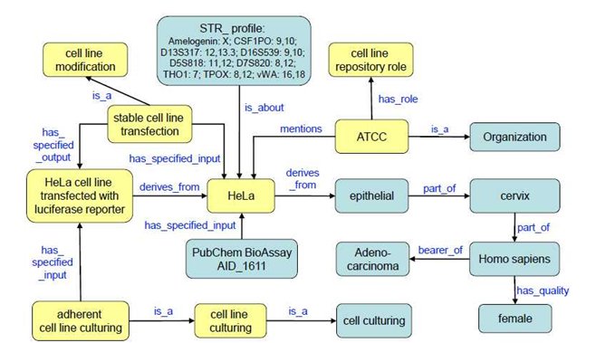
1. CLO Refactoring
Implications
1. Modeling single cell line cells means that CLO cannot directly describe certain characteristics of cell lines as collections that do not apply to single cells - such as passage number, confluence, and seeding density. These attributes would have to be modeled through an associated cell line class (of which the cell line cell is a part).
2. If cell lines are single cells, is there a need to revisit modeling approaches you have previously proposed? For example:
A. This cmap from the 2011 ICBO paper would now hold that a HeLa cell is specified input to a transfection procedure (as opposed to a HeLa cell line being the specified input).
B. Similarly, adherent cell line culturing is modeled as culturing of a single cell, as opposed to the collection of cells.
Notes:
. . . specifically with regard to what are the specified inputs and outputs of various cell culture-related techniques . . .
Curious what people think about this, and if/how the cmap below might look different now that CLO classes such as HeLa will refer to single cells?

Slide 7
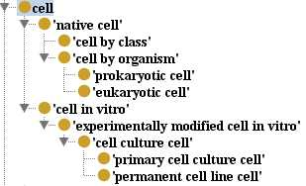
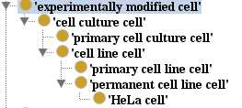
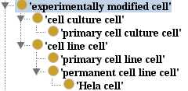
1. CLO Refactoring
Current CL
Updated CL to Accommodate CLO
or
Notes:
. . . depending on the outcome of agenda item 2, regarding how to define the distinctions and relation between a cell culture and a cell line (is a cell line a child of cell culture?)

Slide 8
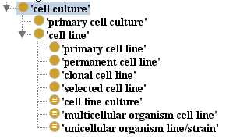
2. Cell Cultures vs Cell Lines
Are ‘cell lines’ subtypes of ‘cell cultures’?
Lets define the key distinctions between these top level concepts:
1. ‘Cell lines’ have necessarily been passaged to attain a (relatively) homogenous culture capable of characterization and propagation.
Based on this distinction alone, ‘cell line’ could be considered a subtype of ‘cell culture’ (a line being any culture that has been passaged).

Slide 9
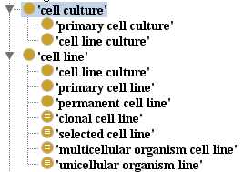
2. Cell Cultures vs Cell Lines
Are ‘cell lines’ subtypes of ‘cell cultures’?
Lets define the key distinctions between these concepts:
2. Strict interpretation of ‘culture’ would require all instances to be under active culture. ‘Cell lines’, by contrast, can exist in a ‘cultured’ state or a ‘quiescent’ state as frozen/lyophilized cells.
Modeling this distinction at the class level means that ‘cell line’ would not be a child of ‘cell culture’ (b/c not every instance of a line would be an instance of a culture).
We would need separate hierarchies for cell cultures and cell lines
A class representing ‘cell line cultures’ would be a child of both cell culture and line
Notes:
Does this interpretation mean also that the culture media is part_of a cell culture? Implications of this?

Slide 10
2. Cell Cultures vs Cell Lines
How to proceed?
Approach 1: cell line as subtype of cell culture
uses a looser definition of ‘culture’ to allow for quiescent lines to be covered. ‘State’ of a culture can be recorded using properties.
Approach 2: cell line (non-disjoint) sibling cell culture
enforces ‘actively cultured’ distinction at the class level.
approach is more complex & could require multiple inheritance
Notes:
At minimum, we should agree on the definitions/scope of cell culture wrt whether cell lines are covered

Slide 11
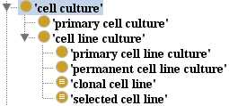
2. Cell Cultures vs Cell Lines
How to proceed?
Approach 3: model all as cultures? (OBI does this now)
Enforces view that cultures are under active culture, and ignores treatment of quiescent lines
- could model these as a separate class?

Slide 12
3. Defining Key Concepts
Core Concepts:
cell culture
cell line
primary cell culture
primary cell line
permanent cell line
clonal cell line
selected cell line
Other proposed concepts:
cell culture mix (Asiyah)
Work from google doc here:
https://docs.google.com/spreadsheet/ccc?key=0AiKzIoedGeqJdE9ZZWY2MHcxTVRlbkhnR0YzVkxrREE#gid=0

Slide 14
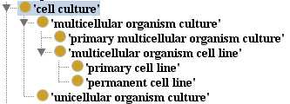
2. Cell Cultures vs Cell Lines

Slide 15
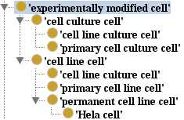
1. Cells

